Slide 1

Proposition HH
The ballot Language:

Slide 2
Prop HH Ballot Language
SHALL THE STATE REDUCE PROPERTY TAXES FOR HOMES AND BUSINESSES, INCLUDING EXPANDING PROPERTY TAX RELIEF FOR SENIORS, AND BACKFILL COUNTIES, WATER DISTRICTS, FIRE DISTRICTS, AMBULANCE AND HOSPITAL DISTRICTS, AND OTHER LOCAL GOVERNMENTS AND FUND SCHOOL DISTRICTS BY USING A PORTION OF THE STATE SURPLUS UP TO THE PROPOSITION HH CAP AS DEFINED IN THIS MEASURE?

Slide 3
Prop HH Ballot Language
SHALL THE STATE REDUCE PROPERTY TAXES FOR HOMES AND BUSINESSES, INCLUDING EXPANDING PROPERTY TAX RELIEF FOR SENIORS, AND BACKFILL COUNTIES, WATER DISTRICTS, FIRE DISTRICTS, AMBULANCE AND HOSPITAL DISTRICTS, AND OTHER LOCAL GOVERNMENTS AND FUND SCHOOL DISTRICTS BY USING A PORTION OF THE STATE SURPLUS UP TO THE PROPOSITION HH CAP AS DEFINED IN THIS MEASURE?

Slide 4
Prop HH Ballot Language
SHALL THE STATE REDUCE PROPERTY TAXES FOR HOMES AND BUSINESSES, INCLUDING EXPANDING PROPERTY TAX RELIEF FOR SENIORS, AND BACKFILL COUNTIES, WATER DISTRICTS, FIRE DISTRICTS, AMBULANCE AND HOSPITAL DISTRICTS, AND OTHER LOCAL GOVERNMENTS AND FUND SCHOOL DISTRICTS BY USING A PORTION OF THE STATE SURPLUS UP TO THE PROPOSITION HH CAP AS DEFINED IN THIS MEASURE?

Slide 5
Prop HH Ballot Language
SHALL THE STATE REDUCE PROPERTY TAXES FOR HOMES AND BUSINESSES, INCLUDING EXPANDING PROPERTY TAX RELIEF FOR SENIORS, AND BACKFILL COUNTIES, WATER DISTRICTS, FIRE DISTRICTS, AMBULANCE AND HOSPITAL DISTRICTS, AND OTHER LOCAL GOVERNMENTS AND FUND SCHOOL DISTRICTS BY USING A PORTION OF THE STATE SURPLUS UP TO THE PROPOSITION HH CAP AS DEFINED IN THIS MEASURE?
Prioritized:
1.Schools 2. Fire Districts 3. Ambulance / Hospital District
4. Local Governments

Slide 6
Prop HH Ballot Language
SHALL THE STATE REDUCE PROPERTY TAXES FOR HOMES AND BUSINESSES, INCLUDING EXPANDING PROPERTY TAX RELIEF FOR SENIORS, AND BACKFILL COUNTIES, WATER DISTRICTS, FIRE DISTRICTS, AMBULANCE AND HOSPITAL DISTRICTS, AND OTHER LOCAL GOVERNMENTS AND FUND SCHOOL DISTRICTS BY USING A PORTION OF THE STATE SURPLUS UP TO THE PROPOSITION HH CAP AS DEFINED IN THIS MEASURE?
TABOR REFUNDS !!!

Slide 7
Title Board ?
"Some of these provisions actually increase the tax," said board member Jeremy Barry.
Board chair, Theresa Conley, agreed that "concerning a reduction in property taxes" wasn't how the question should be worded, "would it be concerning changes of property taxes?"
Caldara says substituting "changes in property taxes" for a "property tax reduction" sends a very different message to voters, "it was very telling to me that the very first thing they did was take out this reduces property taxes to this changes property taxes."
The board didn't stop there. As it tried to draft a ballot question, it noted how complex the measure was. The ballot question its staff came up with ended-up being 140 words compared to Prop HH's 55 words.
The new question went into more detail about what the measure would and would not do. It removed "expanding property tax relief for seniors," for example, and added "creating new subclasses of property."
"That is closer to what the title board would have given Prop HH if it went through proper channels."

Slide 8
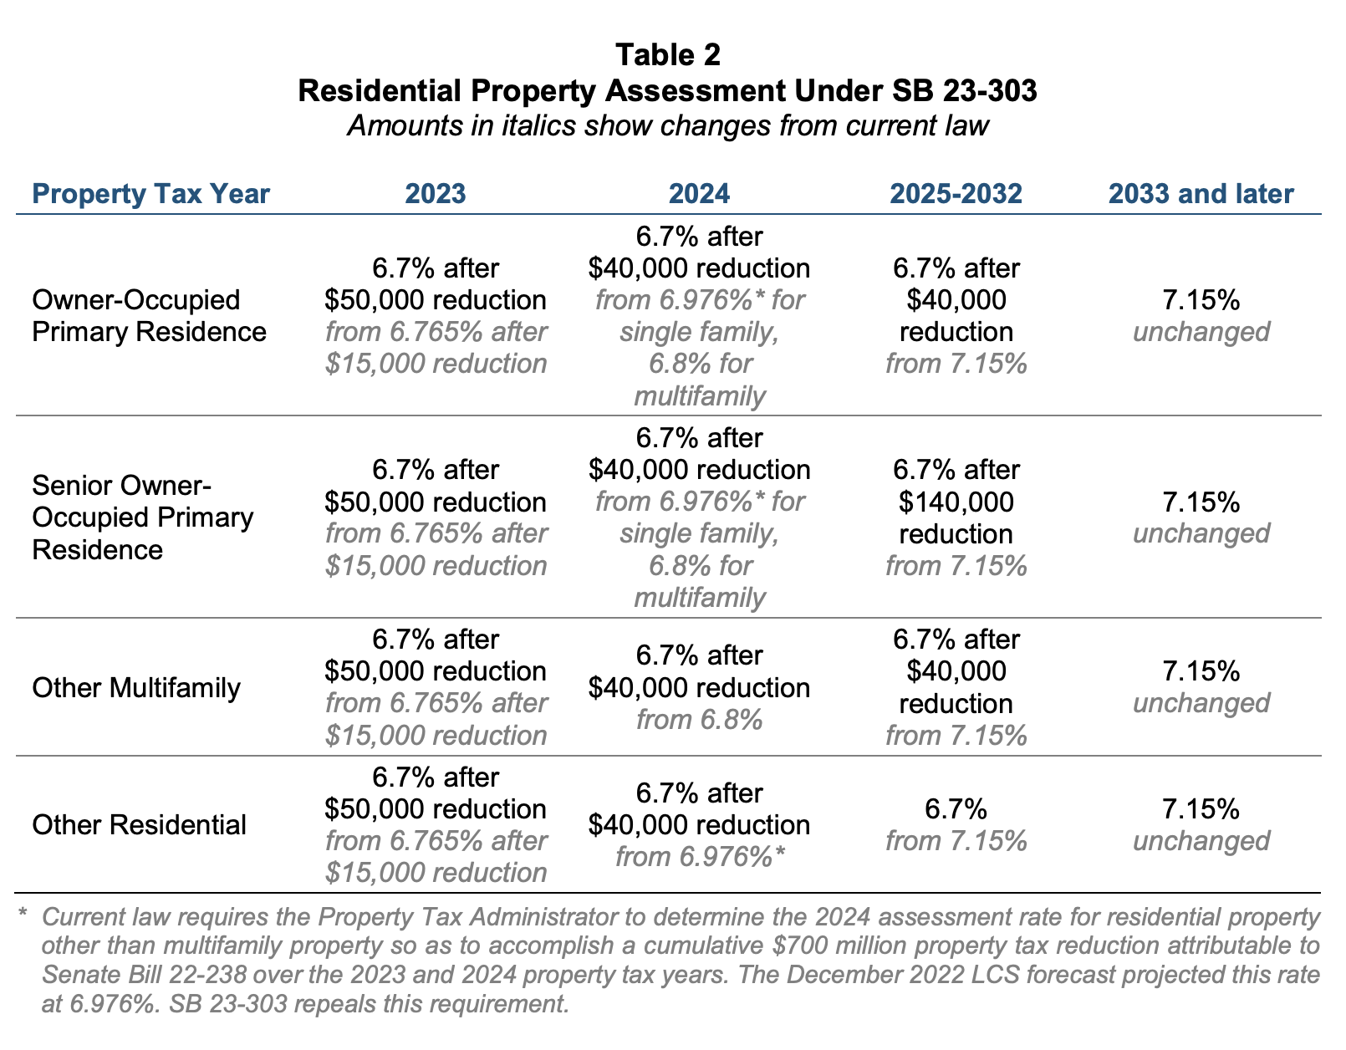

Slide 9
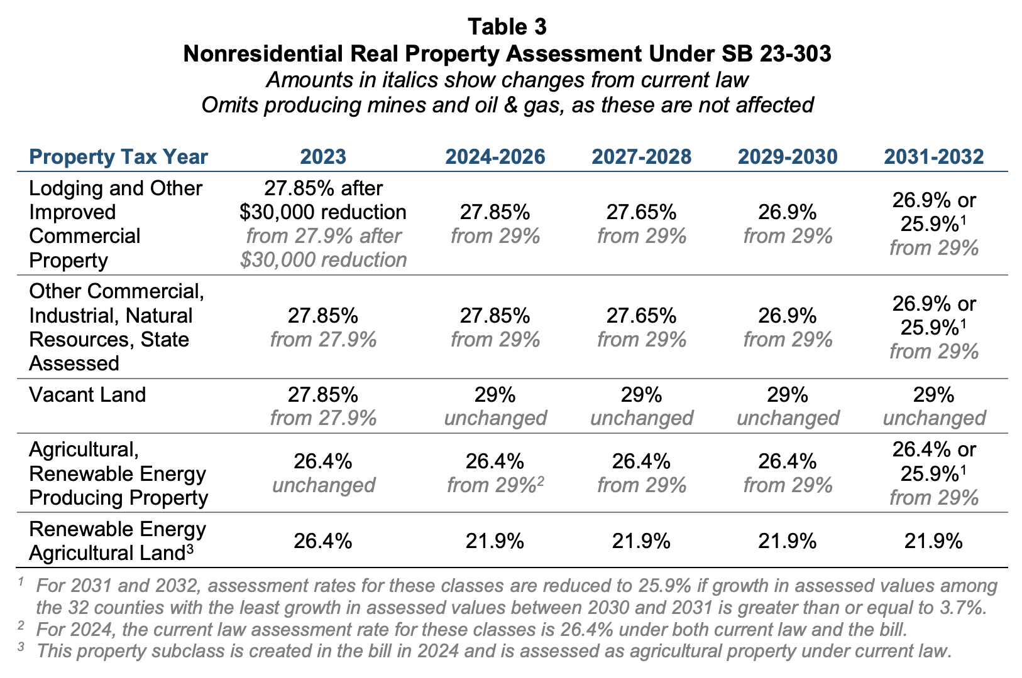

Slide 10
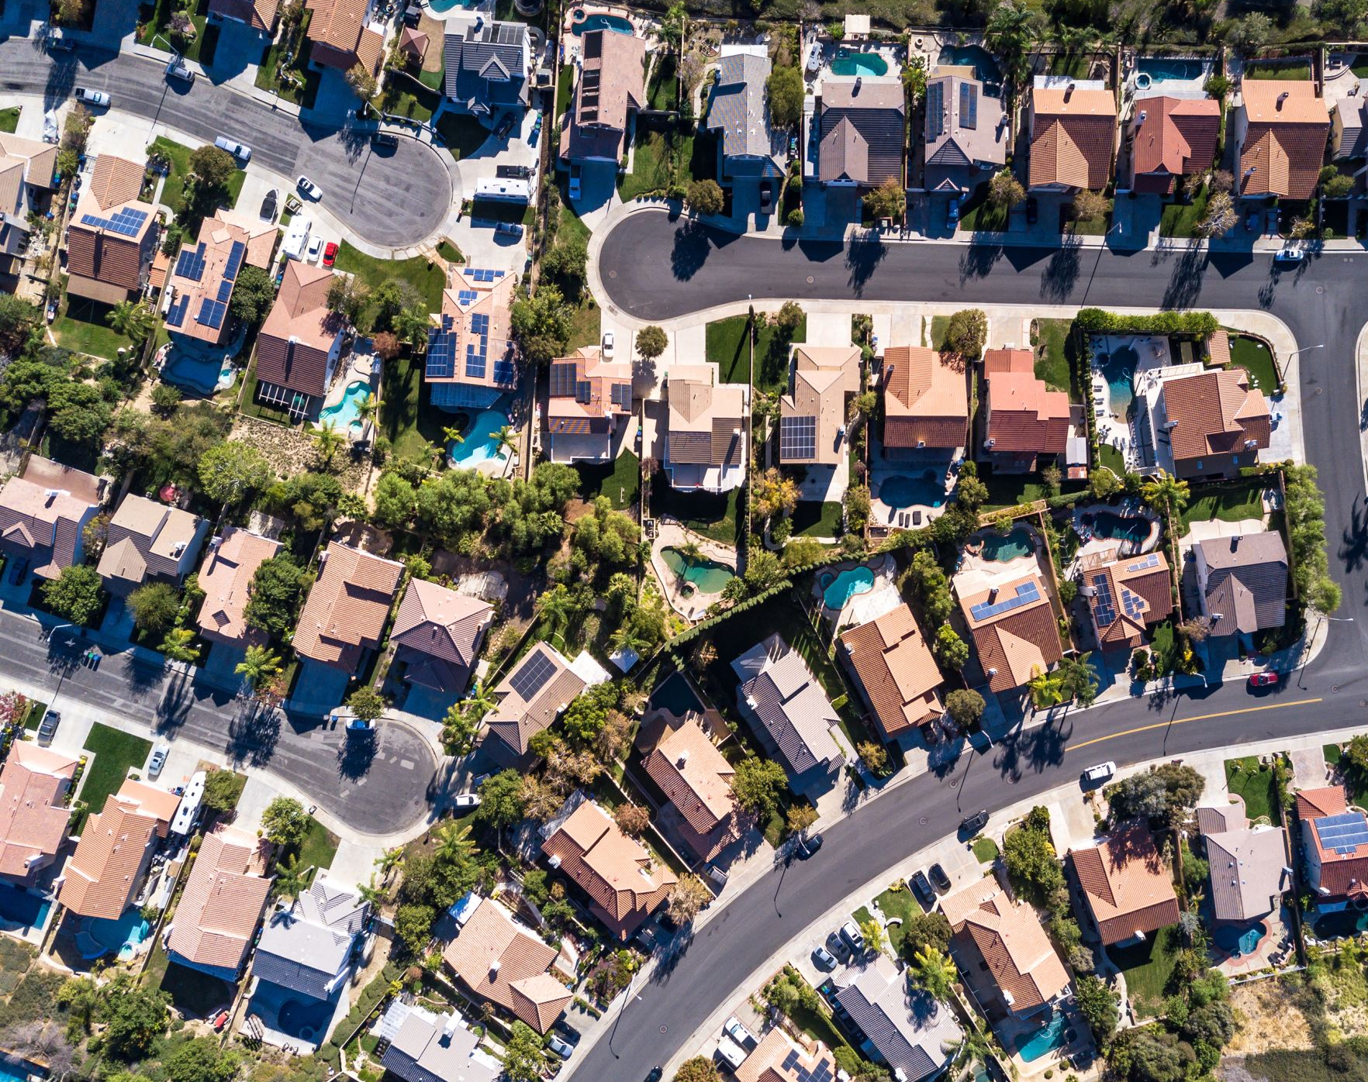
Here’s what taxpayers get out of Prop HH:
Slightly lower assessment rates
Exemption on the first $50,000 of value from residential properties, except non-owner-occupied single-family homes
$50,000 expansion to the senior homestead exemption
  This is the same $50,000 other residential properties receive, not in addition to it

Slide 11
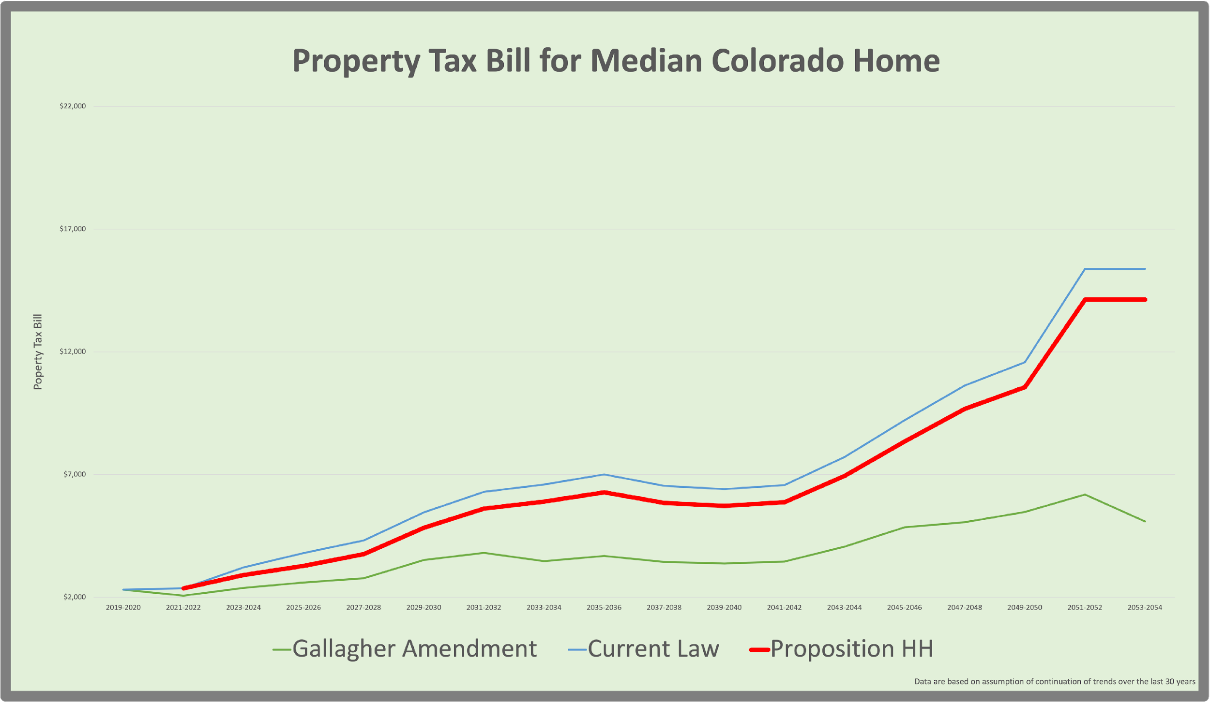
Proposition HH is not long-term property tax reform:
When legislators asked voters to repeal the Gallagher Amendment, they promised a replacement. Prop HH is not a replacement.
Whether HH passes or not, Coloradans will see the largest property tax increase in state history.
If it passes, tax bills will rise slightly less for 2023-2024, then they will continue to rise in future years at the same pace.
The measure does nothing to prevent a 40% or larger tax increase in future years.

Slide 12

Key Takeaways
Proposition HH is a HUGE tax increase.
  It will allow the state to collect $12.5 billion in new taxes over the next decade and $460 billion in new taxes over the next four decades.
  The change to the TABOR cap will effectively end TABOR refunds.
It does almost nothing to alleviate the impending increase in property taxes for 2023 and 2024.
  We will still see the largest property tax increase in Colorado history, but it will be slightly smaller than otherwise.
  The residential assessment rate will drop to 6.7% from 6.765%.
The bill does nothing to prevent large property tax increases in future years.
  For 2023 and 2024, property owners will see a slightly smaller increase in property taxes. Thereafter, property tax bills will continue to grow at the same rate they would without Proposition HH.
  We will be back in the same bind after the next bull market in housing, but our TABOR refunds will be permanently gone by then.

